Slide 1
How does the web work?

Slide 2
Video
What is the world wide web? - Twila Camp - YouTube

Slide 3
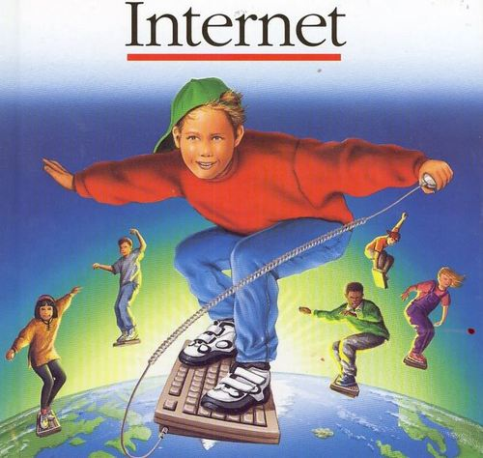

Slide 4
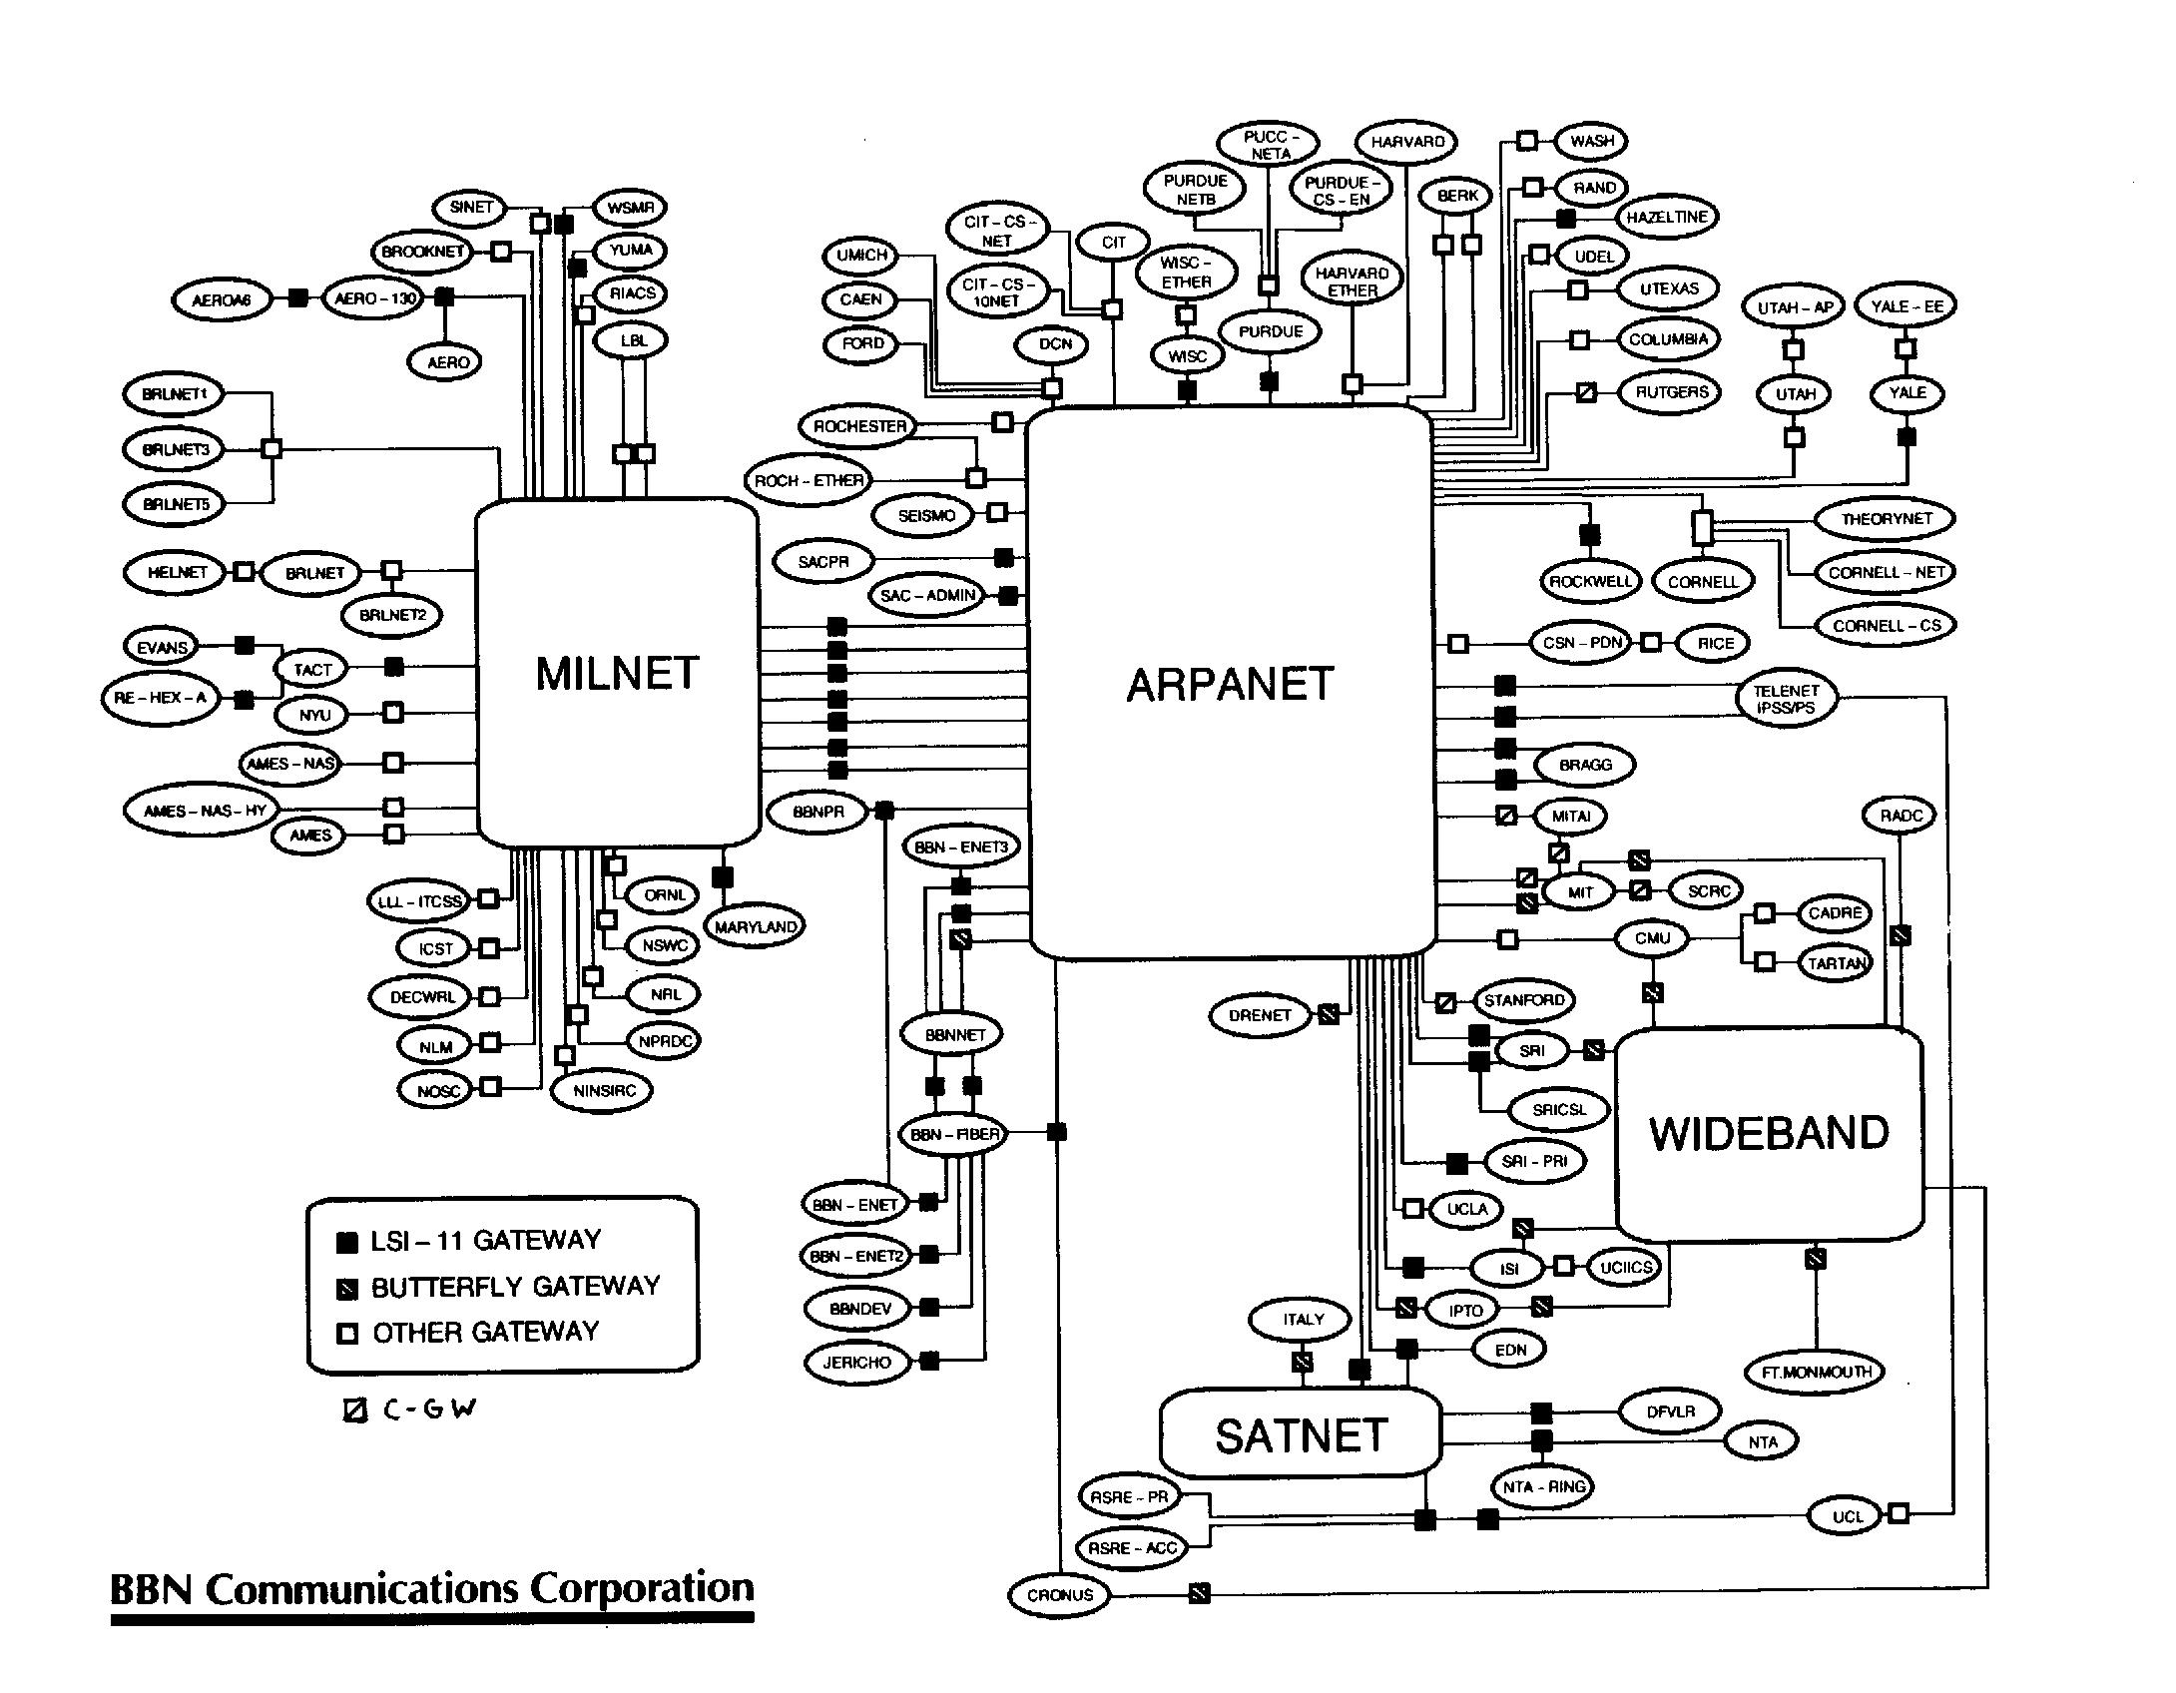
The Internet, approx. 1985
History of the Internet - Wikipedia

Slide 5
The Internet:
Many computers are connected to each other

Slide 6
Some of these computers have a unique IP address
139.59.147.249
2001:0db8:0000:0042:0000:8a2e:0370:7334

Slide 7
Some IP adresses have a unique name
www.awacademy.de
a.k.a. Domain or Hostname

Slide 8
Some of the computers on the internet provide services (server)
Others use these services (client)

Slide 9
DNS
With DNS a name is resolved to an IP address
Usually DNS is provided by your internet service provider (e.g. Telekom)

Slide 10
Domains
Top Level Domain: .de, .com, .horse
Apex Domain: awacademy.de, philipfrank.de
Sub Domain: www.awacademy.de, de.wikipedia.org

Slide 11
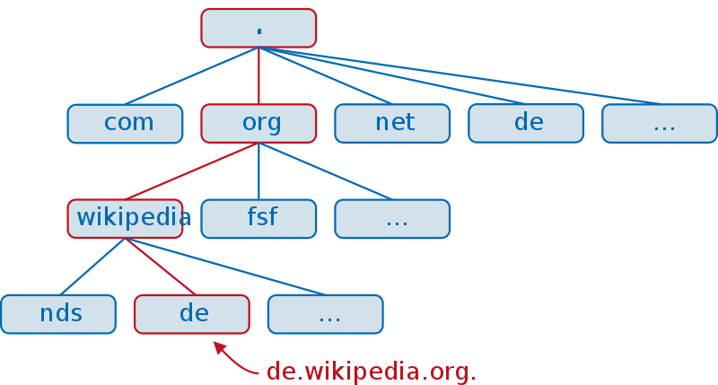
Domains
© Hank van Helvete~commonswiki / CC-BY-SA-3.0

Slide 12
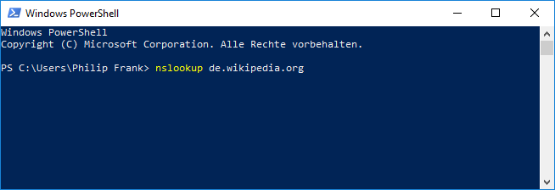
Resolving domains "by hand"

Slide 13
Where does DNS information come from?
Internet Corporation for Assigned Names and Numbers (ICANN)
List of Internet top-level domains - Wikipedia
Registrar
Chaosradio Podcast #250: DNS

Slide 14
TCP: Transmission Control Protocol
Server opens for connections on a specific port (1 - 65536)
Clients connect
Data (bytes) can be sent in both directions

Slide 15
URL
http://de.wikipedia.org/wiki/Internet
How to connect?
Which server?
Path on server?
Pay attention: What other strange parts are there in URLs?

Slide 16
HTTP
Hypertext Transfer Protocol

Slide 17

Hypertext
© pitpony.photography / CC-BY-SA-3.0

Slide 18
HTTP Client
Connect to the server on TCP port 80
Send request
Send blank line
Receive answer

Slide 19
HTTP
Request by client
GET /wiki/Internet HTTP/1.1 Host: de.wikipedia.org
Response from server
HTTP/1.1 200 OK … Überraschung!

Slide 20
HTTP by hand
Write a Java program that uses the java.net.Socket class to establish a TCP connection to www.example.com on port 80.
Send the following data:
GET / HTTP/1.1 Host: www.example.com
Don't forget line breaks and blank line at the end (should end with "\n\n")
Read all lines of the answer from the server and print them out!
Hints: Socket.getOutputStream(), Socket.getInputStream()
Web search "java write to outputstream", "java read from inputstream"
Bonus: what happens for
de.wikipedia.org

Slide 21
HTTP/1.1 200 OK Cache-Control: max-age=604800 Content-Type: text/html Date: Thu, 14 Jun 2018 16:09:49 GMT Etag: "1541025663+ident" Expires: Thu, 21 Jun 2018 16:09:49 GMT Last-Modified: Fri, 09 Aug 2013 23:54:35 GMT Server: ECS (lga/1384) Vary: Accept-Encoding
X-Cache: HIT
Content-Length: 1270
<!doctype html>
<html>
<head>
<title>Example Domain</title>
Status code
Header lines
Body

Slide 22
HTTP Status code
2XX - Success
200 OK
3XX - Redirect
4XX - Client error
404 Not Found
5XX - Server error
List of HTTP status codes - Wikipedia

Slide 23
HTTP Header Examples
Request
Host: de.wikipedia.org
Accept: text/html
User-Agent: Mozilla/5.0 (Windows NT 10.0; Win64; x64; rv:60.0) ...
Response
Content-Type: text/html
Last-Modified: Fri, 09 Aug 2013 23:54:35 GMT
Server: nginx/1.12.2

Slide 24
Cookies
Are transmitted as HTTP headers from the server to the client
Client saves the value (if it wants to)
Client sends future requests as an HTTP header
This is how, for example, a login or advertising tracking works
How can you view, change and delete cookies in the browser?

Slide 25
Web Servers
"Speak" HTTP
Respond, like we have just seen for example.com
The body of the answer is in a format that a web browser understands: e.g. HTML, JPEG or just plain text

Slide 26
Creating web server: Spring
https://start.spring.io/
Create a project template with the spring framework
Group e.g.: de.awacademy
Artifact e.g.: my-first-web-server
Add dependency: Web
Download project, unpack and open with IntelliJ. (File -> Open, then select the folder with a black symbol)

Slide 27
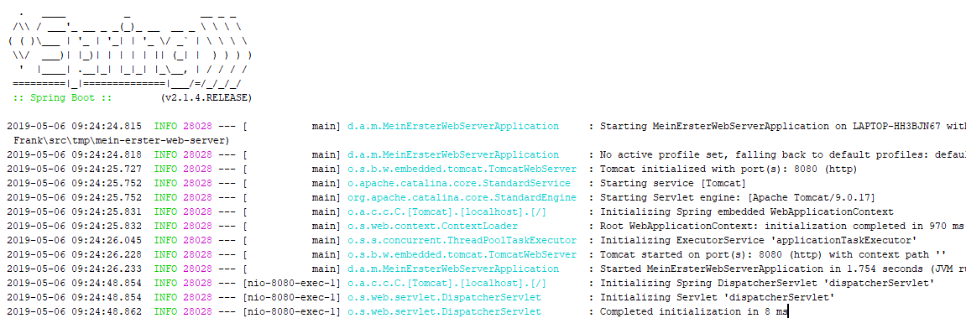
Web Server with Spring
Start the application in Debug mode

Slide 28
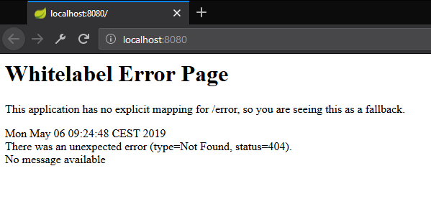
Open in browser

Slide 29
Create controller class
Create a class MyController (name irrelevant for now) in the same package as the existing Application class
Add before public class the annotation @Controller
package de.awacademy.meinersterwebserver;
import org.springframework.stereotype.Controller;
@Controller
public class MyController {
}

Slide 30
Create controller method
package de.awacademy.meinersterwebserver;
import org.springframework.stereotype.Controller;
import org.springframework.web.bind.annotation.GetMapping;
import org.springframework.web.bind.annotation.ResponseBody;
@Controller
public class MyController {
@GetMapping("/")
@ResponseBody
public String index() {
return "This is my server.";
}
}
Name of the method (index) is irrelevant.

Slide 31
Spring: "Magic" Annotations
@GetMapping("/") This method is responsible for requests of the root path / ( Reacts to http://localhost:8080/, but not to http://localhost:8080/hello )
@ResponseBody The return value of the method is the body of the response (Bonus: for more control over the response, return a ResponseEntity<String> )

Slide 32
HTTP in Java
Now use the HTTP client that you wrote first and call your HTTP server with it!
Bonus: Let your server respond once with an error status code (e.g. 404).

Slide 33
HTTP Request Parameter
http://localhost:8000/hello?name=Philip
@GetMapping("/hello")
@ResponseBody
public String hallo(@RequestParam String name) {
return "Hello, " + name;
}

Slide 34
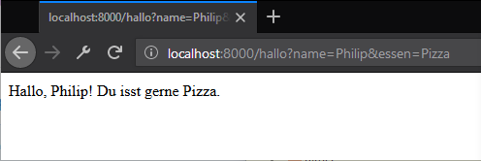
HTTP Request Parameter
http://localhost:8000/hallo?name=Philip&essen=Pizza

Slide 35
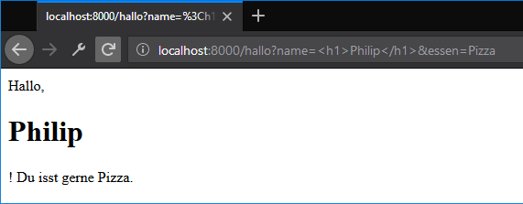
Hmmm… Is this good or bad?

Slide 36
HTML Escaping
A secure website must prevent user input from changing the HTML structure.
Symbols < > " must be removed or escaped
HTML Escaping: replace with &lt; &gt; &quot;
Usually this does not happen until the output, the data is saved in the original format.

Slide 37
HTTP POST
Alternative to GET method
With it, request also has a body
POST parameter are in there, not in the URL as with GET parameters
Allows the transfer of large amounts of data from the client to the server
Blog entry with a lot of text
File upload

Slide 38
HTTP POST
Change the annotation at /hello from @GetMapping to @PostMapping
Beim Pfad /, antworte mit folgendem HTML:
<form action="/hello" method="POST">
<input name="name" placeholder="Your name">
<input name="food" placeholder="A meal">
<button>Go</button>
</form>
Bonus: Simuliere a form user with the Socket client

Slide 39
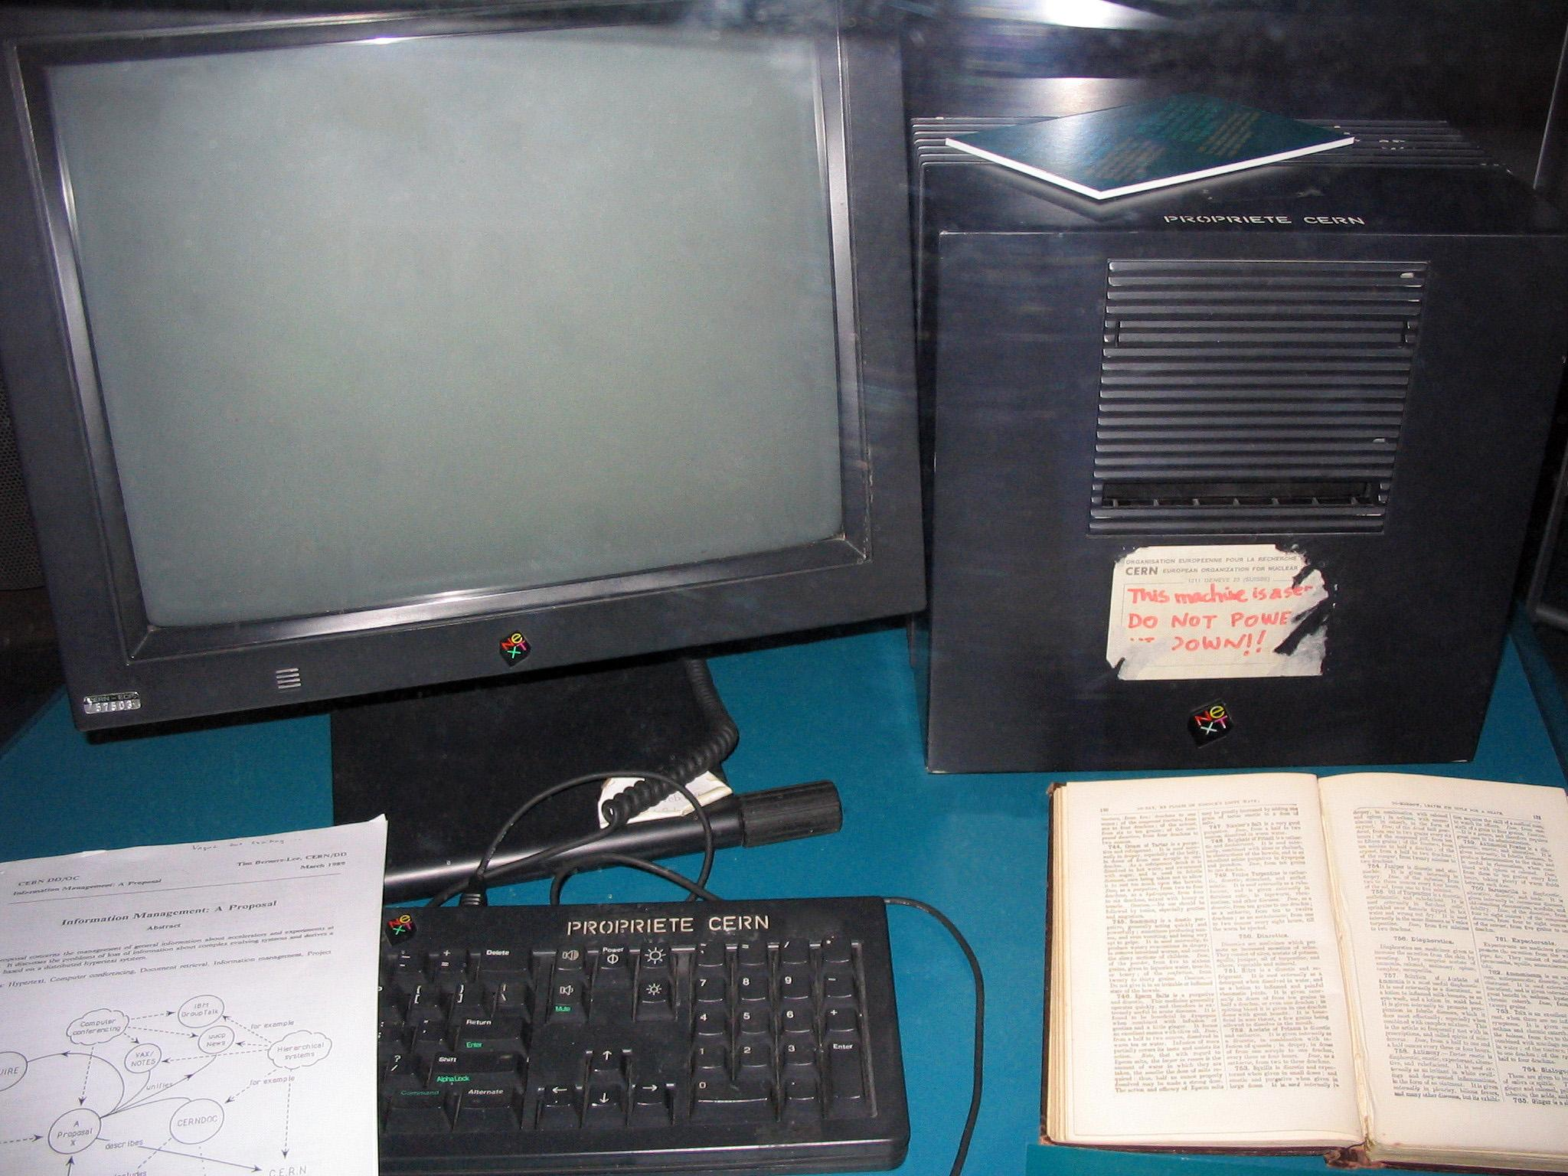
1990

Slide 40
HTTPS
Your internet connection is not necessarily secure!
Is someone reading along?
Does anyone change the content?
Am I even talking to the right server?

Slide 41
HTTPS
Certificate Authorities
Let's Encrypt

Slide 42
Browser Cache
Save data so that you don't have to reload it from the server
e.g.: CSS file that is used in several pages
Relevant HTTP Headers:
ETag (Response) und If-None-Match (Request), Status 304
Cache-Control: max-age=XYZ (Response)
https://developers.google.com/web/fundamentals/performance/optimizing-content-efficiency/http-caching

Slide 43

World Wide Web
DNS + TCP + HTTP + HTML + CSS + JavaScript + Encoding for Pictures, Videos, Audio + ...

Slide 44
Browser Wars
Netscape Navigator vs. Internet Explorer
Internet Explorer vs. Firefox
Google Chrome vs. Firefox
Mobile: Opera vs. Safari vs. Chrome

Slide 45
Popular HTTP Server Software
Apache HTTP Server
LAMP Stack
Nginx
lighttpd
Microsoft Internet Information Server
ASP.NET
Apache Tomcat
Java Servlet, JavaServer Pages, Java Expression Language, ...
Jetty
Java Servlet, ...

Slide 46
What's on the Internet besides the WWW?
E-Mail (e.g. with Outlook)
Skype
ICQ
Multiplayer games
Usually based on TCP (or UDP)

Slide 47
Project: guest book website in Java
HTTP server for a guest book page
Guest book entries consist of name and text content
Your Java program keeps a list of entries
All entries are listed when visiting the website
Every visitor can write new entries using a form at the end of the list
HTML code entered by the user must not destroy the layout
Bonus: Nice, responsive design (e.g. with Bulma)

